Slide 1
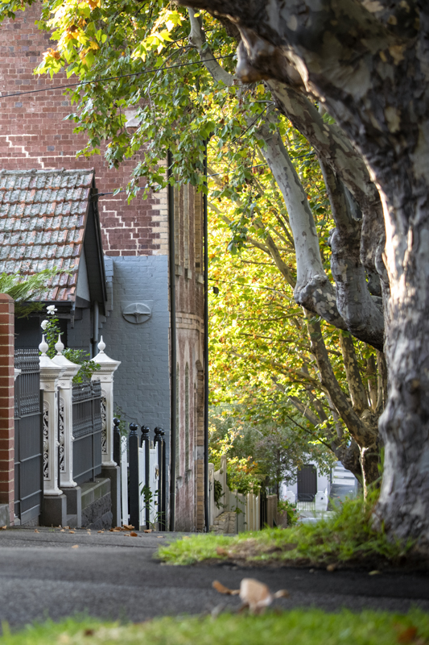
Heritage in your municipality
Councillor / Executive staff briefing template instructions
Using this document:
This document has been created by the Heritage Council of Victoria’s Local Government Specialist Committee to assist council heritage officers/planners when briefing new councillors or executive staff about the heritage in their municipality.
The slides are ‘plain/unformatted’ so that the content can be copied into your specific council presentation templates.
Slides have been kept to the minimum as we understand briefings are typically 15–20 minutes in length.
The structure and content ideas (including the text in the ‘Notes’ fields) are suggestions only – feel free to adjust to suit the needs of your council and the key messages you want to convey.
We suggest using at least one image of the heritage in your area on each slide, to assist in building familiarity and enthusiasm.
Approved by the Heritage Council of Victoria 2 February 2023
(© Hin Lim | HIN LIM AIPP 2020)

Slide 2
[Title:] Heritage 101
[Sub title] An overview of [City/Shire’s] heritage places, policies, strategies, studies and programs.
Notes:
This is the Title slide for the slide pack.
Format according to your council’s presentation style guide

Slide 3
Value of heritage protection – why protect your municipality’s heritage?
Victorians overwhelmingly value their cultural heritage.
Heritage places make significant contributions to sense of place and amenity, community identity and local pride.
[show images of the council-owned heritage that is in use to illustrate this point]
Of all the heritage places protected in Victoria, 90% are protected at the local level (i.e. over 186,000 places). Councils have an important statutory responsibility to protect these places:
To conserve and enhance those buildings, areas and other places which are of
scientific, aesthetic, architectural or historical interest, or otherwise of special
cultural value.
(Planning and Environment Act 1987, Section 4 (1)(d) & VPP Clause 15.03)
Notes:
POTENTIAL SPEAKING NOTES for different points on the slide:
Point 1: Surveys in 2006 found that 95% of Australians agreed that ‘It is important to keep historic features wherever possible when trying to improve towns and cities’. [The Allen Consulting Group, 2005, Valuing the Priceless: the Value of Historic Heritage in Australia]
When similar research was focused on Victorians in 2018, it found that they overwhelmingly place a high value on the state’s heritage stock, and support stricter regulations, higher penalties and better enforcement of heritage regulations to protect it. [SGS Economics & Planning, 2018, The Value of Heritage] [links to both reports can be found on the Heritage Council website].
Point 2: In addition, heritage buildings, precincts and sites are often keystones for the much-vaunted “sense of place” and the unique character of our cities, towns and localities, informing community identity and a sense of local pride.
There is also a growing research base that demonstrates that caring for heritage places and taking part in cultural heritage activities can generate environmental, economic and social benefits. [e.g., see Kate Clarke’s 2011 essay ‘Only Connect’, at https://www.dcceew.gov.au/parks-heritage/heritage/australian-heritage-strategy/past-consultation/comissioned-essays]

Slide 4
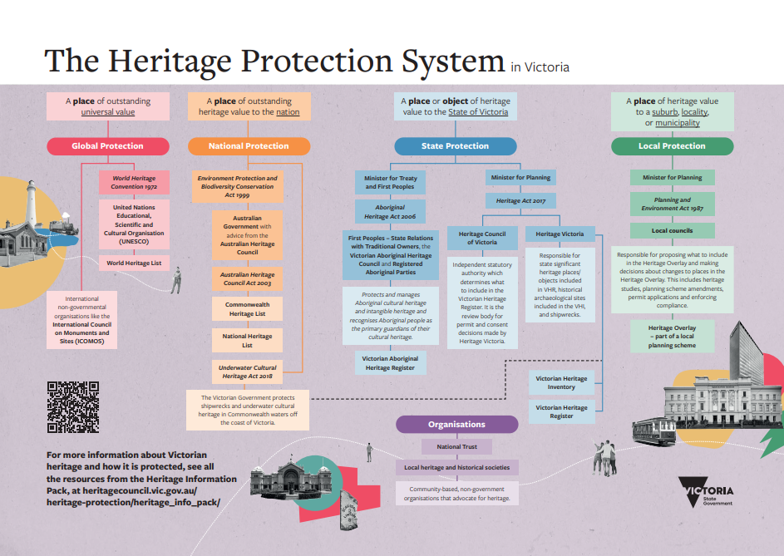
Notes:
NOTES: you can swap this out for the next slide (slide 4) if this is showing too much information.
This image, which provides context for the heritage system as a whole, is one of four posters in the publicly available Heritage Information Pack produced by the Heritage Council (heritagecouncil.vic.gov.au/heritage-protection/heritage_info_pack/). The pack is made up of an animation, four posters and four pamphlets on the following topics:
What is heritage?
Why do we protect heritage?
The Heritage Protection System
What is your role in heritage protection?
The posters and pamphlets are available as online PDFs or print-ready files.

Slide 5
Your council’s role in the heritage protection system
Minister for Planning responsibilities
Authorises municipal councils to prepare amendments to planning schemes. Approves amendments to planning schemes. May prepare an amendment to a planning scheme.* May take responsibility for a planning permit application being assessed by council.* May take responsibility for a planning permit application before the Victorian Civil and Administrative Tribunal (VCAT).* * Powers only used in certain circumstances.
Councils
The recognition and protection of places of local heritage significance via the Heritage Overlay is the responsibility of
councils.
Changing or adding controls
Administering and enforcing the controls
Council as PLANNING AUTHORITY
Council as RESPONSIBLE AUTHORITY
Councils have the power and responsibility under the Planning and Environment Act to:
prepare and adopt heritage studies
develop or implement heritage policies
prepare amendments to the planning scheme
refer submissions about amendments to
independent panel review.
Councils are decision makers under the Planning and Environment Act. They:
make decisions on planning permit applications for changes to places in the Heritage Overlay.
are responsible for the enforcement of the
planning scheme, including in relation to places in the Heritage Overlay.
Notes:
NOTES: you might prefer to use this slide instead of the previous one. This is an extract from the table on page 3 of the guidance document Local government’s role in heritage protection – an introduction for councillors produced by the Heritage Council of Victoria in partnership with the Municipal Association of Victoria (MAV), and which can be accessed by councillors on the MAV website at https://www.mav.asn.au/what-we-do/policy-advocacy/planning-building
POTENTIAL SPEAKING NOTES for different points on the slide:
Heritage in Victoria is primarily managed under three Acts. The Aboriginal Heritage Act 2006, the Planning and Environment Act 1987 and the recently updated Heritage Act 2017 (originally 1995).
Different governing bodies are responsible for different types of heritage protection, but councils have responsibility for heritage protection under the Planning and Environment Act. They also need to be aware of the Aboriginal heritage in their municipality as well as state-listed sites in the Victorian Heritage Register and historic archaeological sites listed in the Victorian Heritage Inventory.

Slide 6
The local context
The area known as [insert municipality] is the traditional lands of the [insert known TO/s].
[City/Shire] is known for its [Victorian terraces/mud brick dwellings/mid-century modern architecture/1920s municipal buildings/other]
We have [no. of] places in the Victorian Heritage Register.
  [highlight any relevant VHR-related permit applications or registration hearing/matters in the last 12 months that the council has been involved in]
We have [no. of] places in the Victorian Heritage Inventory of historic archaeological sites.
We have [no. of] places within the schedule to the Heritage Overlay (HO).
[no. of] are individually significant places
[no. of] are heritage precincts
[no. of] are not buildings but objects or significant trees
[no. of] or [calculate % of whole] include internal or other controls in the HO schedule.
[no of the heritage places – local and state listed] that are council-owned assets
There are also a number of areas of Aboriginal cultural heritage sensitivity.
Notes:
NOTES: This slide is to give a one-page snapshot of the key statistics for your municipality. It might work better in a tabular format depending on the amount of information you have to convey.
When discussing how much of what is heritage-listed is council-owned make the point that the council can lead by example in showing good management of its own heritage assets.

Slide 7
Existing heritage strategies and studies
Council has:
[a Heritage Strategy that coordinates, prioritises and monitors all heritage actions to be carried out]
[a Thematic Environmental History that identifies the key historical themes of the City/Shire]
The [City/Shire] has the following heritage studies:
  [list studies – either on this slide or a separate one]
[a Potential Heritage List that consists of places that could have local significance but require further investigation.]
Notes:
NOTES: Take the opportunity to speak positively about what the council has done and why this is of value.
If the council does not have a heritage strategy, consider taking the opportunity on this slide to speak about why such a document is useful: i.e. it identifies in one whole-of-council document what is known (themes, places of importance/ value to area and why) and where the gaps are, and provides a forward plan for how these will be addressed. This also makes it easier for this information to be carried into related documents such as the council’s Strategic or Business Plan.

Slide 8
Historic themes of importance to [city/shire]
[list the key historic themes (with images) from your Thematic Environmental History that make the municipality important. ]
[consider whether it is useful to highlight new or emerging themes e.g. places of significance to the LGBTQIA+ community]
Notes:
NOTES: When filling this in consider highlighting the following:
If you don’t have a Thematic Environment History make sure any discussion regarding potential themes / heritage / gaps is authoritative/qualified, e.g. you can look to what is in the Overlay in your area to help you say something on this topic.
What are the important key historic periods in your area?
Is there a part of your council that shows this particularly well? (e.g. streetscapes)?
21 councils in Victoria will also need to consider the particular provision (Clause 52.33) in the planning scheme that protects pre-1940 dry stone walls.

Slide 9
Current and future heritage work
Council is currently progressing [insert description of a current heritage amendment, Thematic Environmental History or heritage study or policy project]
  Describe briefly stage of amendment, TEH or study or project and its purpose.
In the [insert time frame depending on particular council plan: e.g. ‘next financial year’ or ‘next budget cycle’ or ‘long/medium/short term’] Council should commence a [study/project/amendment to investigate/amend …]
AND/OR
The [City’s/Shire’s] Thematic Environmental History shows that some areas of the municipality are well represented by the Heritage Overlay, such as [insert example]. Other areas and stories of the [City/Shire] are not yet well represented and require identification and assessment.
AND/OR
The council is required to regularly review and endorse a number of strategic and regulatory documents [e.g. the council Plan, Planning Scheme Review cycle, Municipal local laws] and there is an opportunity to use these documents to have a positive effect on the management of heritage in our area.

Slide 10
Council’s Heritage Advisor role
Council employs a Heritage Advisor [1 day per week or as needs basis]
[Name of advisor] supports council by providing expert advice on heritage places, objects and collections. Application advice for places on the Heritage Overlay is a key part of the role.
They also [apply those relevant to your particular advisor contract]:
  Provide advice to council on its heritage property or asset management
  Provide free advice to owners and managers of heritage places
  Identify places for future assessment and protection
  Provide expert advice on heritage amendments
  Set the priorities of the Municipal Heritage Strategy
  Assist with council’s Heritage Advisory Committee (or similar committee)
  Help administer the Heritage Grants Program (or similar funding program)
  Assist with judging council’s Design Awards

Slide 11
[City/Shire Heritage Grants Scheme]
If municipality has a grants or financial incentives scheme, provide details here.

Slide 12
Thank you
[insert link to your system where councillors can find information].

